Slide 1


HEALTHCARE ANALYSIS
PRESENTED BY:-
GROUP : 3

Slide 2
PROJECT OBJECTIVE
We Used MS-Excel and MySql To Conduct Analysis, Cleaning and Eliminate Duplicates From The Datasets. Then, We Crafted Interactive Dashboards Using Excel, Tableau And Power-Bi Tools, Involving Calculations And Measurement Operations
Dialysis healthcare analytics involves the analysis of key performance indicators (KPIs) to gain insights and make data-driven decisions in the field of dialysis care.
It includes monitoring the number of patients across various summaries, comparing profit vs. non-profit statistics, assessing chain organizations based on total performance scores, analyzing dialysis station statistics, examining category text for expected outcomes, and tracking the average payment reduction rate.
By leveraging these analytics, healthcare providers can optimize care delivery, improve operational efficiency, enhance financial performance, and ultimately improve patient outcomes in the dialysis care sector.

Slide 3
PROJECT CO-ORDINATOR
ABIRAMI R
TEAM MEMBERS
Mr. THOKCHOM AJOY SINGH
Mrs. Monika Hitesh Rampure
Mr Anand Kumar

Slide 4
KPI LIST
Number of Patients across various summaries
Profit Vs Non-Profit Stats
Chain Organizations w.r.t. Total Performance Score as No Score
Dialysis Stations Stats
# of Category Text - As Expected
Average Payment Reduction Rate

Slide 5
DASHBOARDS

Slide 6
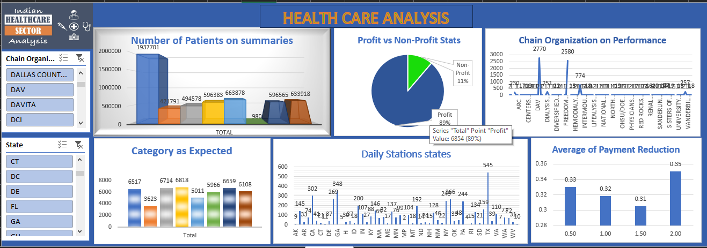
EXCEL DASHBOARD

Slide 7
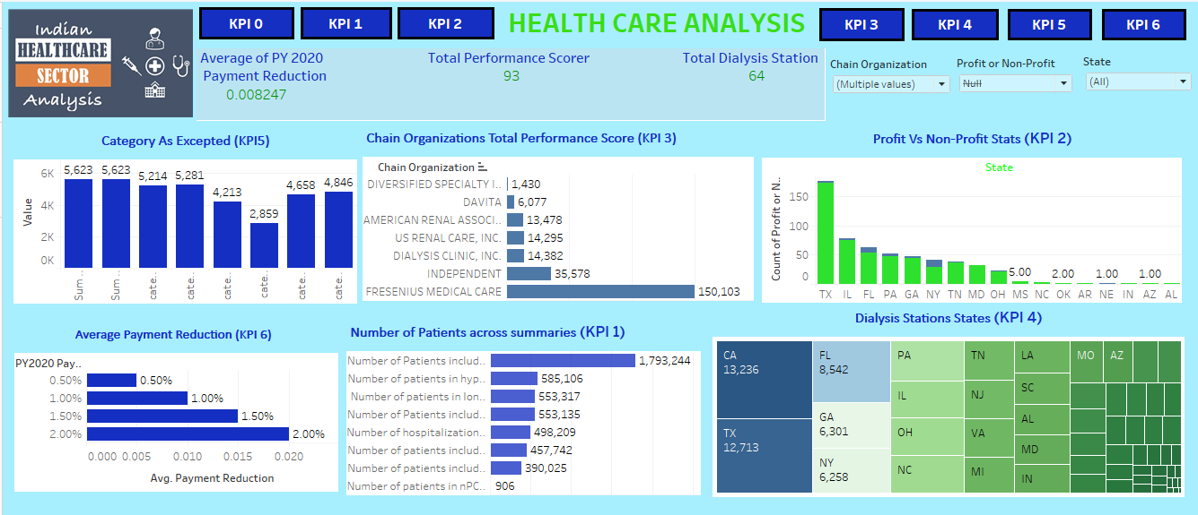
TABLEAU DASHBOARD

Slide 8
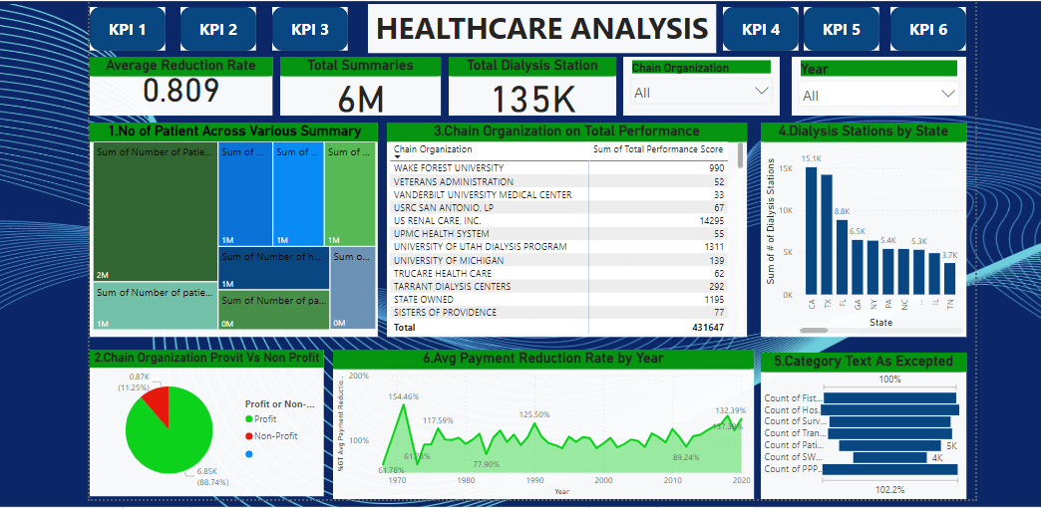
POWER BI DASHBOARD

Slide 9
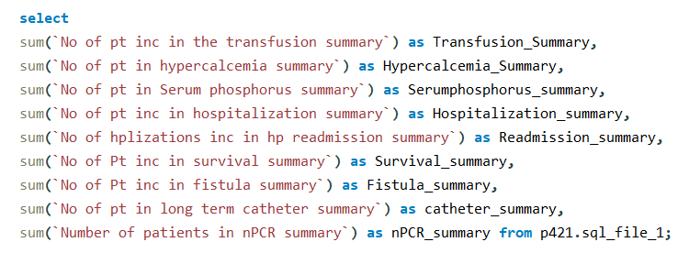
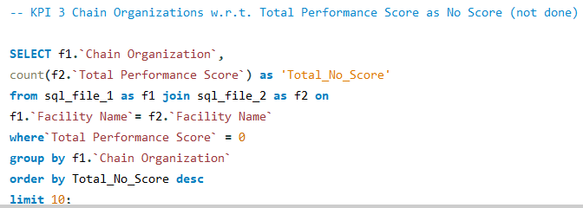

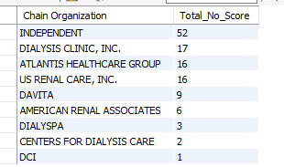

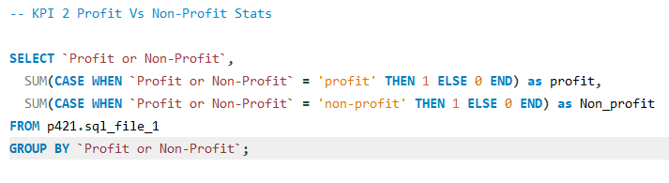

MYSQL

Slide 10
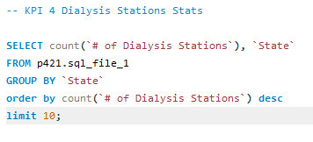
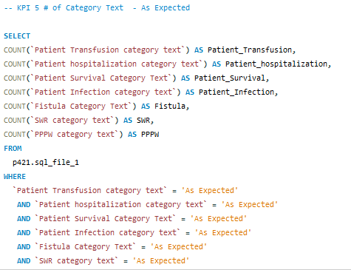
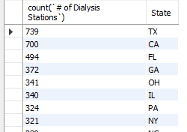
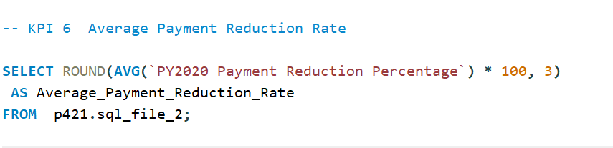

Conti….

Slide 11
KPI EXPLANATION

Slide 12
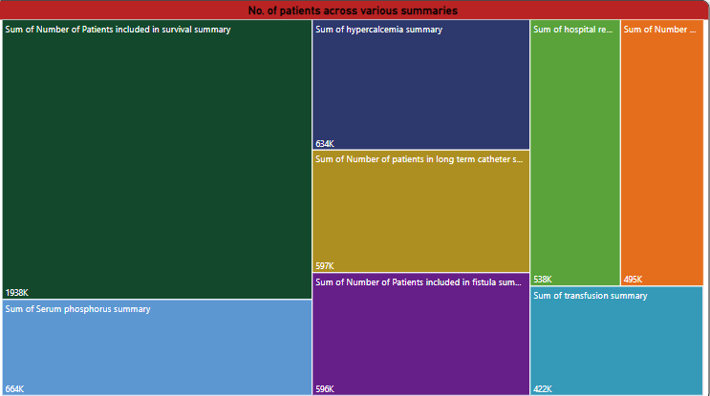
1. NUMBER OF PATIENTS ACROSS VARIOUS SUMMARIES
Analyzing the number of patients across various summaries is a crucial KPI in dialysis healthcare analytics.
It involves tracking the patient population trends, such as the total number of patients, patient demographics, and specific patient summaries (e.g., by age, gender, or medical conditions).
This KPI provides insights into the demand for dialysis services, helps in capacity planning, and assists healthcare providers in delivering personalized care based on patient characteristics

Slide 13
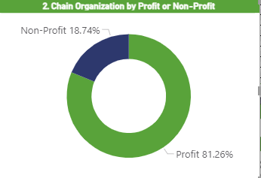
2.Profit Vs Non-Profit Stats
Comparing the financial performance of profit- driven and non-profit organizations is an important aspect of dialysis healthcare analytics.
This analysis involves examining key financial metrics, such as revenue, expenses, profit margins, and return on investment, to understand the economic landscape of the dialysis care sector.
It helps identify the differences in financial outcomes between profit and non-profit organizations and enables stakeholders to make informed decisions regarding resource allocation, cost management, and sustainability of care.

Slide 14
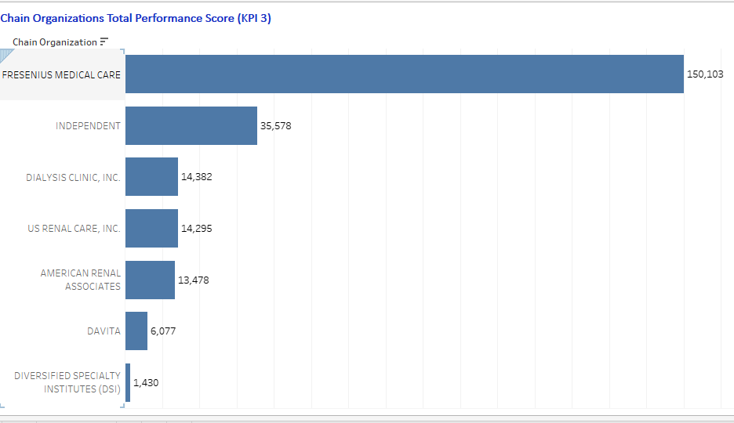
3. CHAIN ORGANIZATIONS W.R.T. TOTAL PERFORMANCE SCORE AS NO SCORE
Assessing chain organizations based on their total performance score, particularly those with no score, is a significant KPI in dialysis healthcare analytics.
The total performance score evaluates various quality measures, patient outcomes, and adherence to best practices.
By analyzing chain organizations in terms of their total performance score, healthcare providers can identify areas of improvement, benchmark against industry standards, and promote quality care delivery across different chains.

Slide 15
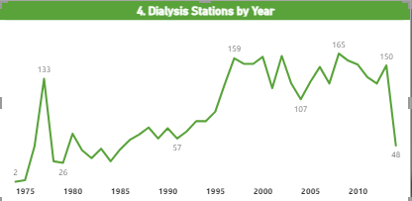
4.Dialysis Stations Stats
Monitoring dialysis stations' statistics is an essential KPI for dialysis healthcare analytics.
This involves tracking the number of dialysis stations, their utilization rates, availability, and efficiency of operations.
By analyzing these statistics, healthcare providers can optimize resource allocation, identify areas of underutilization or overcrowding, ensure equitable access to dialysis services, and improve overall operational efficiency in delivering care

Slide 16
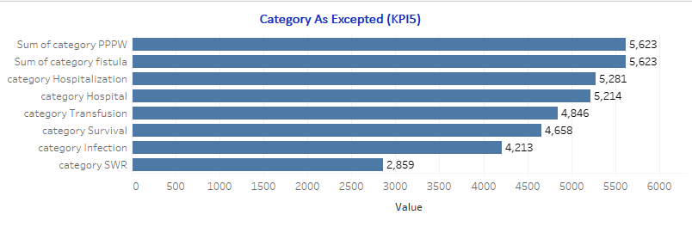
5. # of Category Text - As Expected
Analyzing the # of category text, such as patient classifications or other relevant criteria, is an important KPI in dialysis healthcare analytics.
It involves categorizing patients based on specific criteria and examining their outcomes.
By comparing these outcomes with expectations, healthcare providers can assess the effectiveness of different treatment plans, identify patterns, and tailor care strategies to specific patient categories, ultimately improving the quality of care provided.

Slide 17

6.Average Payment Reduction Rate
Monitoring the average payment reduction rate is a critical KPI in dialysis healthcare analytics.
It measures the rate at which payments for dialysis services are reduced, such as through reimbursement adjustments or contractual agreements.
By analyzing this KPI, healthcare providers can assess their financial performance, identify factors contributing to payment reductions, and develop strategies to mitigate the impact on revenue while maintaining high-quality care standards.

Slide 18
CONCLUSION
Survival summary has the highest patient count, indicating positive outcomes, while npcr summary has the lowest count.
The count of profitable facilities decreased from 2018 to 2020, signaling a concerning trend. DAVITA and Fresenius Medical Care have a majority of profitable facilities
Approximately 88.75% of facilities generate profit, while non-profit facilities need analysis.
The highest performance score was recorded in 1969, while the lowest was in 1971.
Intermountain Healthcare and Memorial Hermann have high performance scores, while others need improvement.
The number of dialysis stations increased until 2018 and then started declining, which is concerning.
The survival category has a good patient count, while hospitalization has the highest count
Implementing cost containment strategies like operational efficiency improvements and optimized supply chain management can reduce costs.
Transitioning to value-based care models and leveraging technology and innovation can optimize healthcare delivery and potentially reduce payments.
Quality improvement initiatives, such as reducing readmissions and preventing medical errors, can lead to cost savings and better payment rates.

Slide 19

THE END

